Slide 1
QCD structure of the nucleon and spin physics Lecture 5 & 6: TMD factorization and phenomenology
HUGS 2015, Jefferson Lab
June 4, 2015

Slide 2
Operator analysis
In the first part of this lecture, I continue the discussion about operator analysis to figure out how many distributions are needed to characterize the nucleon structure
I provide a detailed study for spin-0 particle
I briefly discuss the case for spin-1/2 particle
For details, see
Mulders, Tangerman hep-ph/9403227
Mulders, Tangerman hep-ph/9510301
The next slide continues after I mentioned gauge link
NOTE: all the lecture notes are here
https://www.dropbox.com/sh/kfr8g88qfmx8t8q/AAA7Y1eMnXnBnfl0vnm_usl8a?dl=0

Slide 3
Gauge link: where does it come from?
Existence of the Sivers function (also Boer-Mulders) relies on the interaction between the active parton and the remnant of the hadron
SIDIS: final-state interaction
Drell-Yan: initial-state interaction

Slide 4
Non-universality of the Sivers function
Different gauge link for gauge invariant TMDs in SIDIS and DY
Sivers function and its sign change

Slide 5
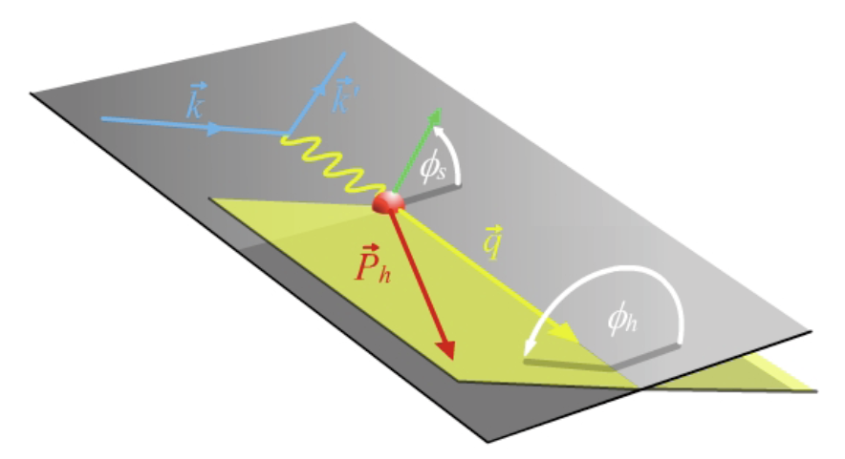
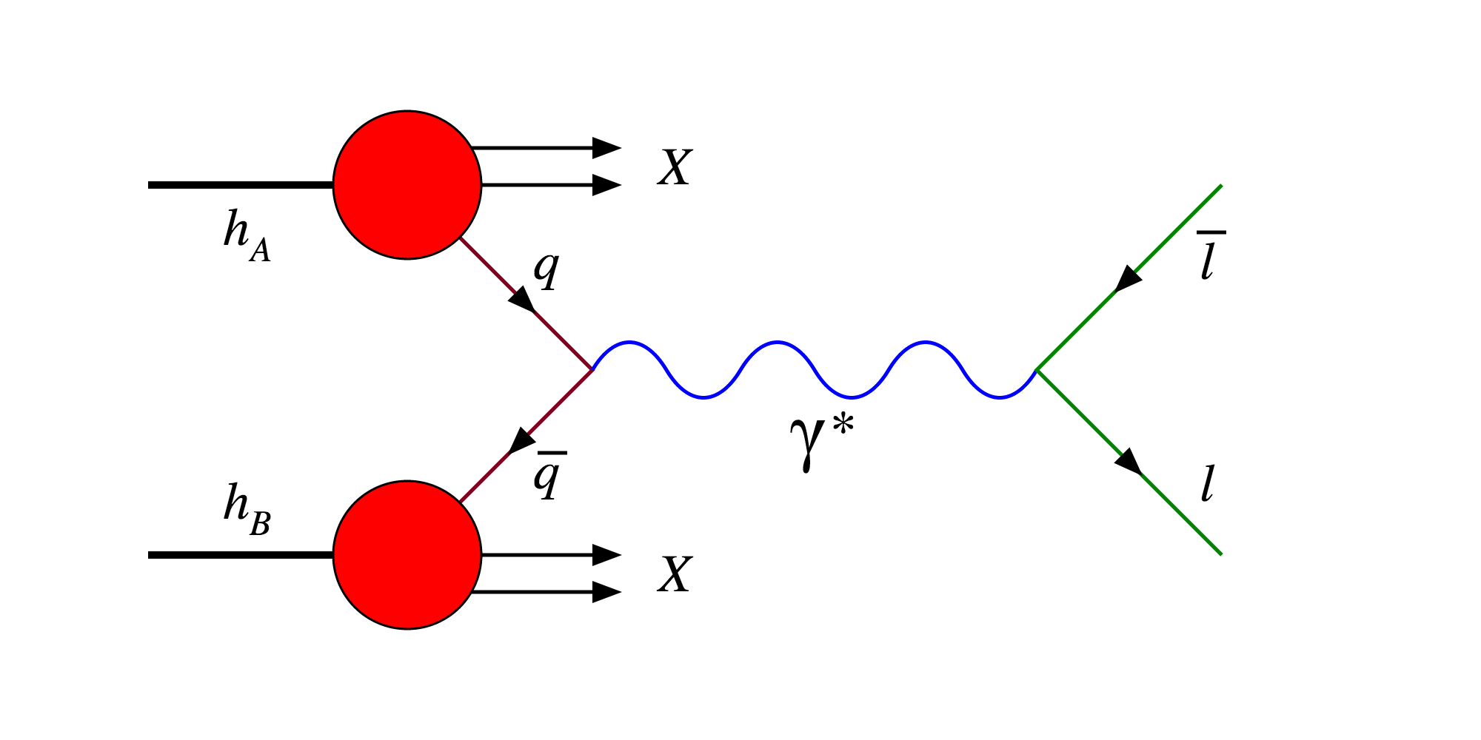
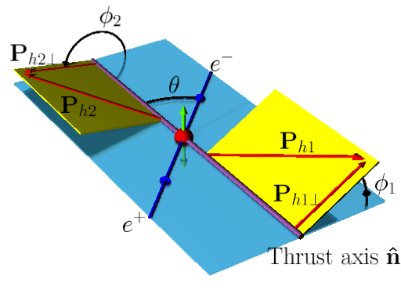
TMD work domain and experimental access
TMD factorization works in the domain where there are two observed momenta in the process, such as SIDIS, DY, e+e-
Q >> qt: Q is large to ensure the use of pQCD, qt is much smaller such that it is sensitive to parton’s transverse momentum
SIDIS
JLab 12, HERMES,
COMPASS
Drell-Yan
COMPASS, Fermilab, RHIC
e⁺+e⁻→h1+h2+X
Belle, BarBar

Slide 6
Access TMDs from SIDIS: see notes for calculations
Separation of different TMD contributions, e.g., Sivers vs Collins
Sivres effect (simple parton model): TMDs are independent of Q

Slide 7
Extraction of Sivers functions
Extraction of Sivers function from SIDIS: JLab, HERMES, COMPASS
Gamberg, Kang, Prokudin, PRL 2013
u
d

Slide 8
Understanding the outcome: d quark
Distortion from Sivers effect: positive = left preference
Unpolarized
Transversely polarized

Slide 9
Understanding the outcome: u quark
Distortion for u quark: negative = right preference
Unpolarized
Transversely polarized

Slide 10
Example prediction: Drell-Yan
Sivers effect: still need Drell-Yan to verify the sign change, thus fully understand the mechanism of the SSAs
Reverse the sign of Sivers function from SIDIS and make predictions for Drell-Yan production
Kang, Qiu, 2010
Q = Lepton pair with invariant mass 4 – 9 GeV

Slide 11
Energy dependence of TMDs
So far the predictions are based on leading order parton model
Experiments operate in very different kinematic ranges
Typical hard scale Q is different: Q ~ 1 – 3 GeV in SIDIS, Q ~ 4 – 90 GeV in pp
Also center-of-mass energy is different
Such energy dependence (evolution) has to be taken into account for any reliable QCD description/prediction
Both collinear PDFs and TMDs depend on the energy scale Q at which they are measured, such dependences are governed by QCD evolution equations
Collinear PDFs
TMDs

Slide 12
QCD evolution: meaning
Evolution = include important perturbative corrections
DGLAP evolution of collinear PDFs: what it does is to resum the so-called single logarithms in the higher order perturbative calculations
TMD factorization works in the situation where there are two observed momenta in the process, Q>>qt: what it does is to resum the so-called double logarithms in the higher order perturbative corrections

Slide 13
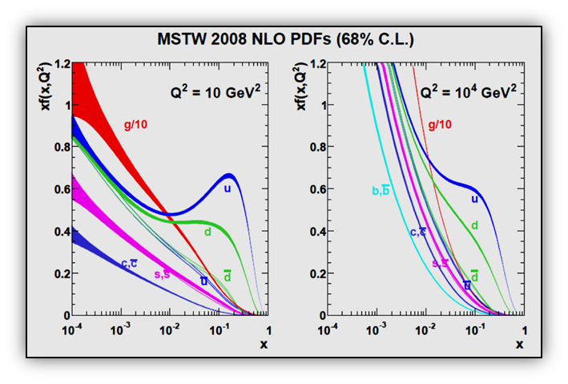
QCD evolution of collinear PDFs
Collinear parton distribution depends on the resolution scale: described very well by DGLAP evolution equations

Slide 14
Main difference between collinear and TMD evolution
Collinear evolution (DGLAP): the evolution kernel is purely perturbative
TMD evolution: the evolution kernels are not. They contain non-perturbative component, which makes the evolution much more complicated but one can learn more
Kt can run into non-perturbative region

Slide 15
TMD evolution
We have a TMD above measured at a scale Q. It is easier to deal in the Fourier transformed space (convolution → product)
QCD evolution of TMDs
Evolution of longitudinal/collinear part
Non-perturbative part has to be fitted to experimental data
Evolution of transverse part

Slide 16
TMD evolution works: multiplicity distribution in SIDIS
Comparison to COMPASS data
Echevarria, Idilbi, Kang, Vitev, 14

Slide 17
TMD evolution works: Drell-Yan and W/Z production
Comparison with DY, W/Z pt distribution
Works for SIDIS, DY, and W/Z in all the energy ranges
Make predictions for future JLab 12, COMPASS, Fermilab, RHIC experiments

Slide 18
Extract Sivers function with energy evolution
Example of the fit: JLab, HERMES, COMPASS
Echevarria, Idilbi, Kang, Vitev, 14

Slide 19
Effect of QCD evolution
What evolution does
Spread out the distribution to much larger kt
At low kt, the distribution decreases due to this spread
Based on Echevarria, Idilbi, Kang, Vitev, 14

Slide 20
Effect of the evolution
Visualization of the Sivers effect for d quark
d quark Sivers is positive, and thus leads to more d quark moves to the left
Let us visualize how this shift changes as energy scale Q² changes: from 2 to 100 GeV²
All visualizations are based on the results from
Echevarria, Idilbi, Kang, Vitev, 14

Slide 21
Visualization for u-quark
U quark is negative = prefer to the right

Slide 22
3D view: d quark

Slide 23
3D view: u quark

Slide 24
DY Sivers asymmetry with energy evolution
Predictions for future DY experiments
COMPASS
Fermilab
RHIC

Slide 25
Phenomenology of transversity and Collins function
Collins asymmetry in SIDIS
Collins asymmetry in dihadron production in e+e- collisions
Prokudin, Kang, Sun, Yuan, 14, 15

Slide 26
Extraction of Collins function
Collins function extracted from experiments

Slide 27
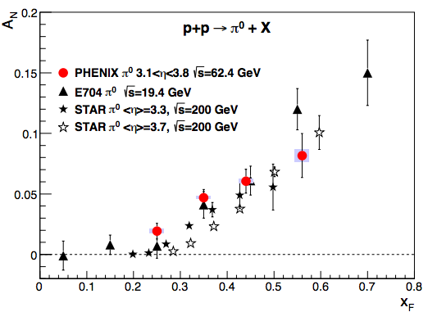
Lots of data from RHIC
Spin asymmetry is also observed for processes in p+p collisions

Slide 28
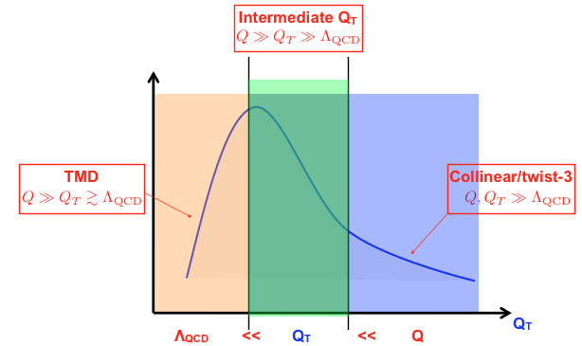
Another formalism
To understand these asymmetries, one needs a formalism called collinear twist-3 factorization
It applies in different kinematic domain, but is consistent with the TMD factorization approach in the overlap region
Ji, Qiu, Vogelsang, Yuan, PRL, 06

Slide 29
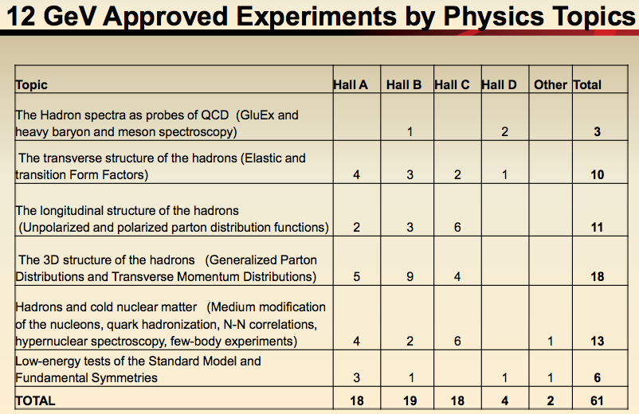
50% Experiments are on spin structure
McKeown, talk at QCD evolution 2014

Slide 30

JLab 12 and EIC
JLab 12 will mainly deliver the nucleon structure in the valence region (relatively large x)
EIC will study the nucleon structure for sea quark and gluons (relatively small x)

Slide 31
Summary
QCD perturbation theory has been very successful in interpreting and predicting high energy scattering process
It provides a solid framework to extract information about hadron structure
JLab 12 has exciting experimental program on nucleon spin structure, with 10+ years program; after that, EIC is the highest recommendation for the new construction in nuclear physics – bright future
Bright future: make up your own mind

